Slide 1
Chapter-4
Skills and Values in Business Communication

Slide 2
Communication skills
Being able to communicate effectively is perhaps the most important of all life skills. It is what enables us to pass information to other people, and to understand what is said to us.
Communication is defined as the ability to convey or share ideas and feelings effectively. Several experts agree that communication skills include: Conveying messages without misinterpretation or misleading others.
Communication, at its simplest, is the act of transferring information from one person to another. It may be oral, written (using printed or digital media such as books, magazines, websites or emails), visual (using logos, maps, charts or graphs) or non-verbal (using body language, gestures). In practice, it is often a combination of several of these.

Slide 3
Communication skills may take a lifetime to master. There are, however, many things that you can do to improve your communication skills and ensure that you are able to transmit and receive information effectively.
Here are the top communication skills employers and recruiters want to see in your resume and cover letter, interviews and career development:

Slide 4
1. Active listening
Active listening, sometimes called appreciative listening or mindful listening, means paying close attention to who you're communicating with by engaging with them and asking questions.
Practicing active listening can build respect with your colleagues and increase understanding in the workplace.
As you actively listen, focus on the speaker and avoid distractions like cell phones and laptops.
Improve your active listening skills by paying attention to other people's facial expressions, body language and tone of voice.
Instead of preparing what you plan to say next, focus on what the other person is saying and how they're speaking. If you want to clarify something, ask follow-up questions or rephrase what they've said to confirm that you understood them correctly.

Slide 5
2. Using the right communication medium
Using the right way to communicate is an important skill. There are benefits and disadvantages to communicating through emails, letters, phone calls, in-person meetings or instant messages.
Communicating is better when you consider your audience, what information you want to share and the best way to share it.
For example, if you're communicating with a potential employer, it may be better to send a formal email or call them on the phone. In the workplace, you may find it easier to communicate complex information in person or via a video conference than by email. Building remote workplace friendships is easier when you can communicate through instant messages.

Slide 6
3. Friendliness
Friendly traits like honesty and kindness can help building trust and understanding when communicating at work.
Try to communicate with a positive attitude, keep an open mind and ask questions to help you understand.
Small gestures such as asking someone how they're doing, smiling as they speak or offering praise for work well done can help you to maintain productive relationships with colleagues and managers.
You can practice friendliness by remembering small, thoughtful details about your colleagues or past conversations. For example, if a colleague tells you their child's birthday is soon and you connect with them again later, you might ask them how the birthday party went.

Slide 7
4. Confidence
In the workplace, people are more likely to respond to ideas that are presented with confidence.
There are many ways to appear confident: by making eye contact when you're addressing someone, sitting up straight with your shoulders open and preparing ahead of time so your thoughts are clear and you're able to answer any questions.
Confident communication is useful not just on the job but also during the job interview process.
Additionally, to display confidence, avoid adding filler words like: um, ah, hmm, like etc.

Slide 8
5. Sharing feedback
Strong communicators can accept constructive feedback and provide constructive input to others.
Feedback can answer questions, provide solutions or help strengthen the project or topic at hand.
Providing and accepting feedback is an essential workplace skill, as it can help both you and the people around you make meaningful improvements to their work and their professional development.
A great way to learn how to give feedback is to take notes from others on the feedback they offer you. When you come across a well-explained piece of feedback, take some time to observe and analyze why it was good, why it resonated with you and how you might apply those skills in the future.

Slide 9
6. Volume and tone
When you're speaking, be clear and audible.
Adjusting your speaking voice so others can hear you in a variety of settings is a skill, and it's critical to communicating effectively.
Speaking too loudly may be disrespectful or awkward in certain settings.

Slide 10
7. Empathy
Having empathy means that you can not only understand but also share in the emotions of others.
This communication skill is important in both team and one-on-one settings. In both cases, you attempt to effectively read and translate other people's emotions and select an appropriate response.
For example, if someone is expressing anger or frustration, empathy can help you acknowledge and diffuse their emotion. At the same time, being able to understand when someone is feeling positive and enthusiastic can help you get support for your ideas and projects.

Slide 11
8. Respect
A key aspect of respect is knowing when to initiate communication and respond.
In a team or group setting, allowing others to speak without interruption is seen as a necessary communication skill tied to respectfulness.
Respectfully communicating also means using your time with someone else wisely—staying on topic, asking clear questions and responding fully to any questions they've asked you.
9. Nonverbal cues
Some amount of communication happens through nonverbal cues such as body language, facial expressions and eye contact.
When you're listening to someone, you must pay attention to what they're saying and their nonverbal language.
It's essential to not judge others based on their body language, as not all people display the same physical gestures due to cultural or ability differences.

Slide 12
10. Responsiveness
Whether you're returning a phone call or sending a reply to an email, employers often view fast communicators as more effective than those who are slow to respond.
One method is to consider how long your response takes. Is this a request or question you can answer in the next five minutes? If so, it may be a good idea to address it as soon as you see it. If it's a more complex request or question, you can still acknowledge that you've received the message and let the other person know you're going to respond in full later.

Slide 13
Soft Skills in the Workplace
Soft skills include a combination of social and interpersonal and communication skills while hard skills refer to the expertise and knowledge one needs to perform the job.
Employers valued soft skills more than core hard skills.

Slide 14
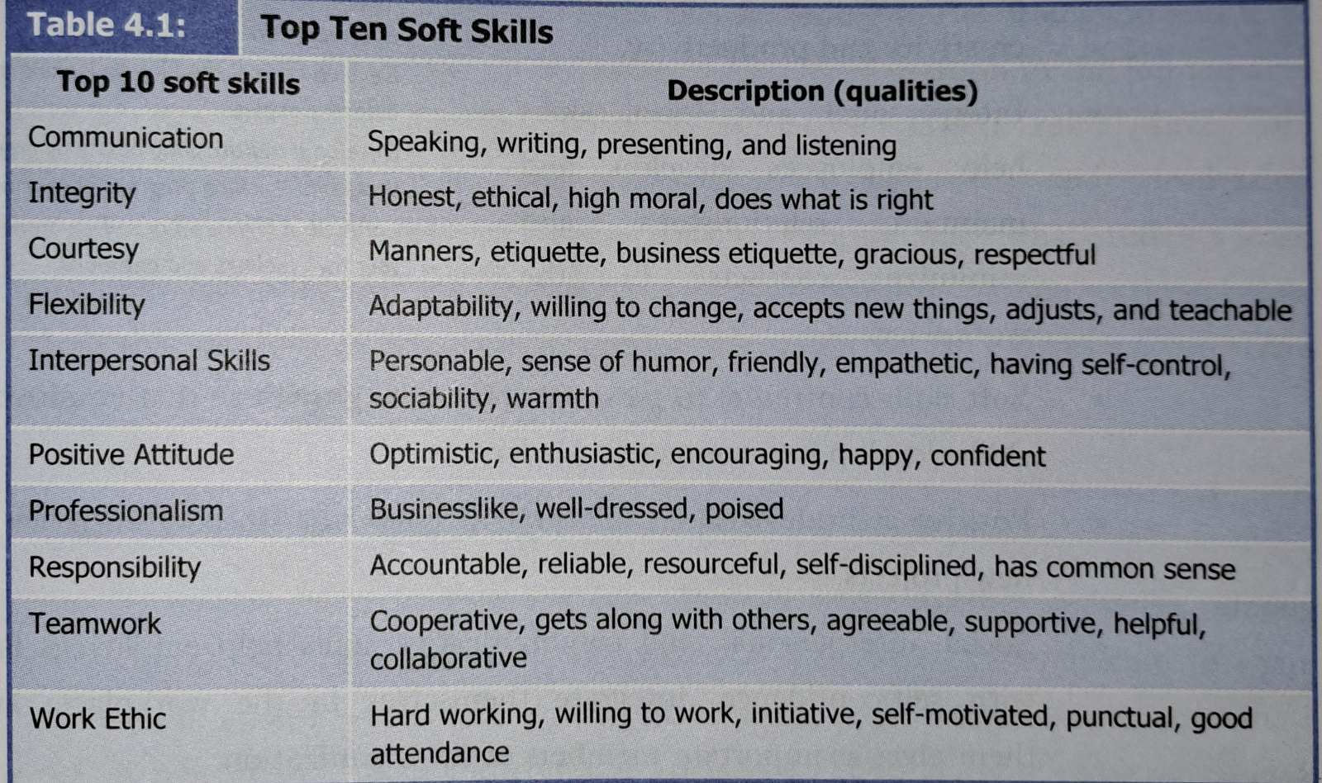

Slide 15
Importance of Soft skills
As employers place premium value on soft skills, graduates with excellent social interpersonal and communication skills are more likely to be employed in competitive job market.
Employees with soft skills can easily adapt to different working conditions, make quick adjustments, multi-task and learn new work procedures with minimum level of orientation or training.
It enables employees to connect with people within and outside the organization and help them develop networks.
Employees with excellent soft skills provide synergy(combined action) and lead groups and teams; they enhance creativity and productivity.

Slide 16
5. Interpersonal and social skills help employees develop and maintain relationships and minimize conflicts in the workplace.
6. Soft skills contribute to personal and career growth so that employees with such skills develop into competent leaders.
7. Positive attitudes and creativity allow employees to take initiative and develop new projects.
8. Social, interpersonal and communicative skills help employees face problems with self confidence, integrate themselves in the workplace and establish themselves as important members of the organization.
9. Soft skills determine the success of an employee’s social interaction, ability to mediate conflicts on behalf of the employer and also helps promote the company’s image.

Slide 17
Organizational Communication Skills
Organizational communication involves sending and receiving messages among interrelated individuals within the organization.
In an organization, employees communicate to share information, maintain relations, express emotions as well as coordinate work.
Main purpose of organizational communication is to achieve individual and common goals.
Organizational communication helps to accomplish task-related goals, adapt to the working environment, implement policies and develop relationships.
Communication in an organization not only helps to convey information related to work rather it creates social world within the organization and develops a culture.

Slide 18
Oral, written and electronic are the primary media of communication used in an organization.
To flourish in the workplace, you should speak clearly, listen actively and write precisely as well as logically.
One should also need skills in handling technology to communicate with colleagues, managers and stakeholders.
Awareness of the organizational communication system – flows and directions of information – helps to adapt the organizational communication environment.
Organizational communication largely depend on the culture prevalent in the organization.
Organizational culture provides an outline of what you should pay attention to and what you should not do in an organization.

Slide 19
An employee should have to develop certain communicational skills:
Receiving and giving instructions
When you work, you have to receive and give instructions to team members, co-workers and clients on various matters related to work procedures, products and services.
Such information can be oral, written or electronic.
To increase the effectiveness your instructions, you should speak clearly and write precisely.
Avoid using direct imperatives.
While receiving instructions, pay attention to details and ask questions to clarify information.

Slide 20
Listening
While listening , listen for the content and pay attention to body language.
Listening helps to build relationships, increase productivity, develop networks, collaborate effectively and influence people.
Listening also reduces misunderstanding and conflicts.
Good listener focus on the entire message and avoid selectively listening to what they want to hear.
They can demonstrate that they are listening by providing feedback such as nodding, asking questions, making eye-contact and displaying open body postures.

Slide 21
Networking
Communication is also about connecting with people and building relationship.
Being able to get others interested in your ideas is the basic step to building a network of individuals who can work together, collaborate and achieve common goals.
Active listening, use of positive language and readiness to initiate communication are some of th important aspects of network building.

Slide 22
Negotiating
Negotiating means to reach a mutually beneficial solution.
People have different views and ideas leading to an initial disagreement.
Through communication- face-to-face conversations, discussions and dialogues – differences can be minimized and parties involved in negotiation can come to an agreeable position.
One should be considerate, value other’s ideas and show readiness to accept alternative views to lead to a mutually beneficial solution.

Slide 23
Working in teams
A team is a working unit of two or more people formed to accomplish a task.
Organizations seek employees having the ability to work in teams and collaborate with members of a working team.
Teams are ideal to handle bigger and more complex projects as the members of the team bring their skills and expertise and collaborate to accomplish the task.
With the development of collaboration technologies such as MS Teams, Skype, Flow and Slack, organizations these days increasingly rely on team work.
One need effective communication and interpersonal skills to succeed in an organization where teamwork and collaboration are highly valued.
To be a good team member you should show respect to others, use positive language, participate in group discussions, take initiative and give constructive feedback.

Slide 24
Problem-solving
Problem-solving involves finding the sources of the problem, researching and understanding it, and reaching an acceptable solution. In each step communication is a key component.
Communicative skills such as an ability to express thoughts with clarity, convince others, and argue for the right solution help come out with a better solution to the problem.

Slide 25
Interpersonal Communication Skills
Interpersonal communication means face-to-face communication between two or more person about exchanging information, expressing feelings and emotions, and building relationships.
Verbal and non-verbal cues are the most important symbols used in interpersonal communication.
In an organization, interpersonal communication among employees promote collaboration, creates a good working environment, raises employees’ motivation.
Conversations, meetings, discussions, interviews and performance reviews are some examples of interpersonal communication.

Slide 26
Qualities like: empathy, assertiveness and cultural sensitivity help to develop interpersonal communication skill.
Empathy is the ability to understand other’s feelings which helps you relate with another person.
Assertiveness means to have conviction or belief and your readiness to stand by your belief develops assertiveness.
There are people from different cultural backgrounds working together in an organization. Your awareness of cultural differences and the respect you show to other cultures enables you to connect with people from diverse cultural backgrounds.
The following skills are considered to be important aspects of interpersonal communication:

Slide 27
Active Listening
Listening requires the ability to pay attention to what others say and how they say it.
Employees often complain against their managers is that “they don’t listen” to them. “not listening” here means not paying attention to and not being open to others’ ideas.
Verbal as well as non-verbal cues are important signals to understand what someone really means.
When you listen to what the speaker is saying, consider the following:

Slide 28
Pay complete attention to the speaker focusing on what they are saying and how they are saying it.
Ask questions to let the speaker know that you are interested.
Provide verbal and non-verbal feedback such as nodding and slightly leaning towards the speaker.
Avoid judging right away; instead listen to the speaker entirely and then share your thoughts.
Display appropriate body language – open postures, eye contact, friendly facial expressions.
Avoid giving advice until you are asked to.

Slide 29
Regulating Skills
During conversation, speakers use regulating skills to stay focused and protect order and clarity of conversation.
There are basically three elements of regulating skills: setting goals, evaluating goals and closing the conversation.
When you initiate the conversation, you should clearly state your intention of speaking. Use expressions such as “I would like to talk to you about……” or “I have been meaning to ask you about……”. You can set the specific agenda of the conversation.
During the conversation, you can evaluate the goal and discuss the agenda set at the beginning.
Closing the conversation is always tricky. So, depending on the purpose of the conversation, you can summarize the points at the end of the conversation. Recapping the outcomes is another good way of closing the conversation.

Slide 30
Building Rapport
Rapport building mean to develop trust and friendship with a conversation partner.
In our everyday experience, we find it difficult to begin a conversation.
For people to feel comfortable talking and sharing ideas, they have to build rapport.
Rapport building does not happen automatically. It is a skill that you can learn.
To build rapport, you have to put in some effort to reach out to the other person – matching the person’s conversation style, sharing common experiences, connecting emotionally and even matching the voice quality.

Slide 31
Emotional Control
Employers expect their employees to conduct themselves in a professional manner.
Expression of strong emotions – both positive and negative – is considered unprofessional.
Moreover, an excessive display of negative emotions such as anger, unhappiness and frustration is not only unproductive, but also have negative impact in interpersonal relationship.
To manage and control emotions, you need the ability to be aware of your own emotions and also of those with whom you communicate.
The kind of tone you use in speech and writing indicates your emotions and attitudes. So, avoid using sarcastic, aggressive and dismissive tone or voice.

Slide 32
Building Trust
Trust can be defined as the confidence we have in others’ abilities and intentions.
Building trust is one of the primary purposes of interpersonal communication.
Trust brings people together and allows them to share ideas, experience and feelings. So, trust is the foundation of relationships.
Your skills, qualifications, expertise and sincerity help you earn trust from your peers.
To earn trust, you should maintain consistency in your actions and behaviors.

Slide 33
Leadership Communication Skills
As organizations are increasingly becoming democratic, managers’ power and authority no longer originate from their position within the organization. Instead, they have to rely heavily on their communication skills to manage a company, motivate employees and convince stakeholders (person with an interest or concern in sth) of their future plans.
That is why, communication skills have become important management and leadership tools.
Moreover, employers seek excellent leadership skills in their employees because regardless of their job position they have to lead team frequently, initiate discussion, make decisions independently.
Leadership communication mainly relates to how management and team leaders communicate to team members, staff and stakeholders.

Slide 34
The following elements are identified as the important traits of leadership communication:
Adapting appropriate communication styles
Leaders use communication to motivate, inspire and build trust as well as goodwill for which they need to adjust their communication style (pace, tone, wording and body language) to address the audience’s needs.
A leader whose communication style does not match with the employees cannot inspire and motivate the employees.
Leader’s readiness to change communication style to meet the expectation of team members, staff and stakeholders develops cohesiveness and bonding in the team.

Slide 35
Active listening
Often people talk and open up to those who speak like them and share their values.
Active listening to what others say and how they say it helps you to obtain information and feedback that are valuable for solving problems, revising policies and adapting new strategies.
Openness and transparency
Communication gap between the management and the employees cause mistrust and demotivate employees.
By speaking openly about the company’s goal, vision, mission and strategies, leaders can gain trust and motivate employees.

Slide 36
Ability to ask questions
Managers need to understand how employees feel, what their motivation level is and what their goals and strategies are.
For this, managers must engage with employees and ask them to share problems, information and explain things.
Receiving and implementing feedback
Receiving feedback and information is not sufficient.
A good leader acts upon and implements the suggestions provided by team members.

Slide 37
Empathy
Empathy is identified as one of the important leadership skills.
Empathy brings people together and creates an emotional connection.
A leader’s demonstration of empathy towards employees makes them feel valued and motivated.
In this sense, leadership communication must demonstrate genuine concern and understanding of employees’ problems and feelings.

Slide 38
Professionalism in Business Communication
The word ‘profession’ refers to a work that requires specialty, expertise and academic qualification.
Professionalism means to demonstrate the requisite qualification and expertise needed to perform the job.
Professionalism also refers to the conduct, behavior and attitude that one displays in a workplace.
To sum up the 2nd and 3rd point, professionalism refers to the competency and appropriate interpersonal and social behavior that the profession requires.
Companies give much importance on employees’ professionalism as they operate within established norms and standards of behavior.

Slide 39
The following are considered to be the defining elements of professionalism:
Appearance
Appearance is the first and the basic element of professionalism.
It reflects the personality of the employee.
Companies give importance to the employees’ appearance because the employee’s appearance projects the company’s image.
In the business world, you are expected to wear casual attire and present yourself confidently.
Your overall demeanor (outward behavior) and body language should be positive, energetic and confident.

Slide 40
Expertise and competence
Competence is the ability to perform duties effectively, including the ability to work and make decisions independently.
It requires knowledge, skills and sound judgment.
Your relevant job knowledge and ability to do the job well help establish your credibility.
Competence also includes communicative skills. That is to say, you need to speak clearly and correctly, write precisely and logically, and use words that reflect your knowledge and skills relevant to the job.

Slide 41
Accountability
To be accountable is to take responsibility for your work and actions especially when you make mistake.
It is unethical and unprofessional to put blame on others for your actions.
Accountability also includes taking responsibility for the work carried out under your leadership and supervision.
For example, if the completion of the project is delayed being a team leader you are responsible no matter who or what caused the delay.

Slide 42
Consistency
Consistency is defined as a quality of performance and actions that do not vary over time.
A sudden change in the way you speak, act and perform in a job creates uncertainty.
Peers and co-workers will not trust a person whose behavior and actions are unpredictable.
By remaining consistent in your speech, behavior and actions, you present your credibility.
Inconsistency also leads to unethical decision making.

Slide 43
Integrity
Integrity is to be honest to oneself and to others both in actions and communication.
It also means to live by ethical and moral principles.
Integrity requires you to back up your words with action and communicate with honesty and sincerity.
Believing in one thing and saying something else to please someone is considered a violation of the principle of integrity. Similarly, promising to do something and not doing it also compromise integrity.

Slide 44
Ethical Values
Ethics refers to our ability to differentiate right from wrong.
Ethical values concern our ability and willingness to do the right thing.
Ethical values requires us to go beyond our self-interest and immediate gain to respect, protect, serve and help others.
The elements discussed above – honesty, integrity, accountability – are also ethical values.

Slide 45
Ethical Dilemma versus Ethical Lapse
Ethical Dilemma
A dilemma is a situation in which you are not able to make a decision.
To make it simple, if you have two or more choices and you are not sure which one to choose in a given situation, you are facing a dilemma.
However, if both alternatives have some undesirable consequences, you have an ethical dilemma.
In other words, an ethical dilemma is a situation in which there are two or more options, but neither of them are the best ethical or moral options.

Slide 46
Ethical Lapse
Ethical lapse is a failure to behave in an ethical way in some specific situation.
It is a deliberate and calculated choice that is unethical.
In ethical lapse, your information is not only false, it is deceptive and misleading.
Although violation of ethics in business has legal consequences, businesses are frequently found to have committed ethical lapses.
Even though a lack of personal ethics and integrity are the obvious reasons for ethical lapses, there are other factors contributing to it.

Slide 47
According to Leheman and DuFrene, the following causes for ethical lapses:
Excessive focus on profit by the managers
Lack of corporate loyalty
Influence of personal interest in employees’ decision-making
Employees’ unwillingness to take a stand
Excessive emphasis on the present rather than the future goals

Slide 48
Guidelines for Ethical communication
Any form of communication that is deceptive, manipulative and untruthful is unethical.
One should follow the following principles of ethical communication at the workplace:
Be honest and truthful
Be objective and no-judgmental
Be responsible and accountable
Respect privacy and confidentiality
Adhere(stick) to legal and regulatory constraints

Slide 49
Intercultural/Cross-cultural Sensitivity
Intercultural sensitivity is the ability to recognize, respect and accept cultural differences.
To communicate effectively to person from different cultures, one need a high level of sensitivity.
In 1986, Milton J. Bennett proposed the most comprehensive model of intercultural sensitivity.
The model scales an individual’s reaction to cultural differences.
Basically, it demonstrates the different ways individuals respond when they encounter differences.

Slide 50
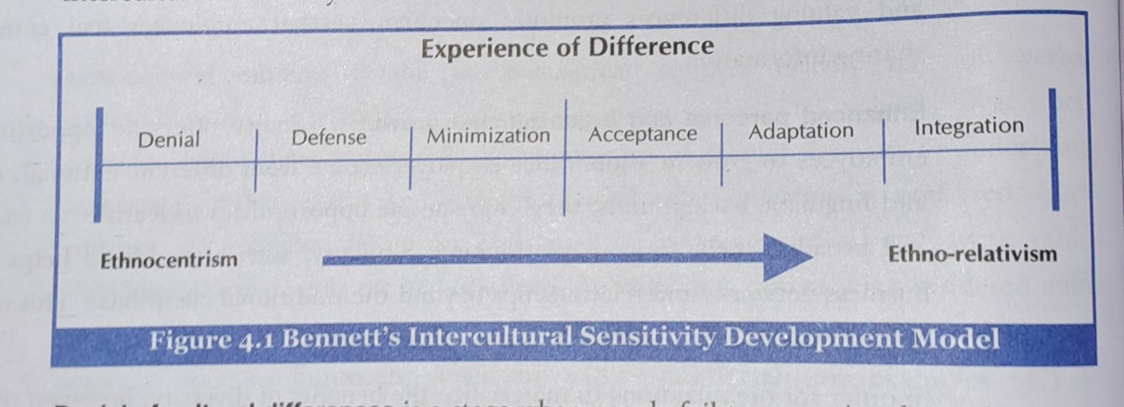

Slide 51
In the figure, the first three stage show a complete lack of intercultural sensitivity. This phase is marked as ethnocentrism.
Ethnocentrism is a tendency to judge other groups as per the standard behavior and customs of one’s own culture.
Such perception is biased and does not recognize the differences among cultures.
Bennett’s scale shows how one can move from stage of ethnocentrism to ethno-relativism, a condition in which individuals not only accept cultural differences but also adapt to such differences.
Ethno-relativism is the ability to accept behaviors and values as cultural not universal.

Slide 52
Characteristics of intercultural sensitivity:
Denial of cultural differences
In this stage people fail to recognize that cultures are different and there are no universally applicable sets of behavior, customs and traditions.
This is the stage of total lack of cultural sensitivity.
A failure to see the differences leads to stereotyping.
Stereotype is a mistaken idea or belief many people have about a thing or group that is based upon how they look on the outside, which may be untrue or only partly true. Saying that “teenagers do not respect their parents” is a stereotype because it assigns a general attribute to all the teenagers despite their individual differences.

Slide 53
Defense against cultural difference
It is a situation when people perceive other cultures as threatening, undesirable and disruptive.
They advocate the superiority of their own culture and tends to defend their own interests.
Such perception often leads to discrimination, including the efforts to deny people from other culture an access to resources and opportunities.

Slide 54
Minimization of cultural differences
In this stage, people consider their own cultural values as being universally applicable.
The tendency to emphasize the similarities among people and cultures rather than the differences is an example of the minimization stage.
The implicit assumption is that other cultures should follow the values related to the dominant culture.

Slide 55
Acceptance of cultural differences
This is the first sign towards developing intercultural sensitivity.
In thus stage, people recognize that there are differences between cultures. Behaviors, customs and traditions are culture-specific and are equally valid within the culture.
They also realize that such differences should be respected. This realization leads to the learning phase where people want to learn and understand cultural practices and values related to other cultures.

Slide 56
Adaptation of cultural differences
This occurs when people not only accept cultural differences but adapt the perspective of another culture.
In this stage, people tend to appreciate others’ experiences and share information without reservation.
This phase is characterized by an openness to discuss differences with people from different cultural backgrounds.
People mutually adapt to each other’s cultural practices without necessarily abandoning one’s cultural identity.

Slide 57
Integration of cultural differences
This happens when people incorporate values, behaviors, customs and practices belonging to other cultures into their own lives.
This mostly happens when people from non-dominant groups live and adjust with the dominant groups.
Particularly, immigrants and diaspora tend to adapt to the host society’s cultures and integrate the values in their own way of life.

Slide 58
Improving Intercultural Communication Skills
Develop intercultural sensitivity
There are three aspects of intercultural sensitivity – acceptance, adaptation and integration.
One should avoid using stereotypes and ethnocentrism while communicating in the workplace.
You need to avoid assuming that others will act and behave in the same way as you do as people act and behave differently.
So, you need to avoid judging people on the basis of their behavior and other cultural practices such as food habits, dressing, mannerism, and how they look and appear.
Moreover, every individual should be treated as a unique being, not as a generalized category.

Slide 59
Recognize variations and differences
As workplaces are increasingly becoming diverse, there exist a range of variation in terms of the attitude to work, the concept of time, use of language and gestures.
When you communicate to people from different culture, make sure to keep differences of attitudes, language and mannerism in mind.

Slide 60
Learn about other cultures
For effective intercultural communication, you need to learn about other cultures so that you can familiarize yourself with unique and culture-specific values, mannerism and communicative styles.
Before meeting a person from another culture, prepare yourself by researching on and gathering adequate background information about the culture that allows you to interact more confidently and friendly way.

Slide 61
Write clearly
While corresponding to people from another culture, you should be aware of the format and style of writing preferred in that culture.
Use simple and clear language.
Avoid using idiomatic and slang expressions.
Use transitional words and phrases.
Be brief and straightforward.

Slide 62
Speak and listen carefully
Speaking any second language is always challenging.
It is hard to approximate the native speaker’s pronunciation, tone, stress pattern and pitch level.
Moreover, the same language varies from one region to another in terms of accent, grammar and word meaning.
These regional variations make it difficult to orally communicate to people from another region and culture even if both parties use the same language.
While speaking to an audience from another culture:
Speak distinctly and slowly
Avoid rephrasing immediately after you speak
Ask for feedback
Pronounce the words correctly

